Slide 1
Machine Learning Foundations and Applications
Jiaul Paik

Slide 2
Topics
Convolutional Neural Network

Slide 3
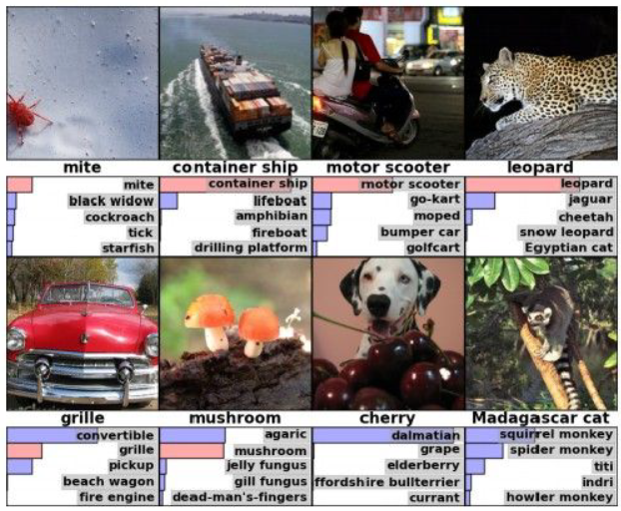
CNN Applications: Image Classification
Source: Alex Krizhevsky, 2012

Slide 4
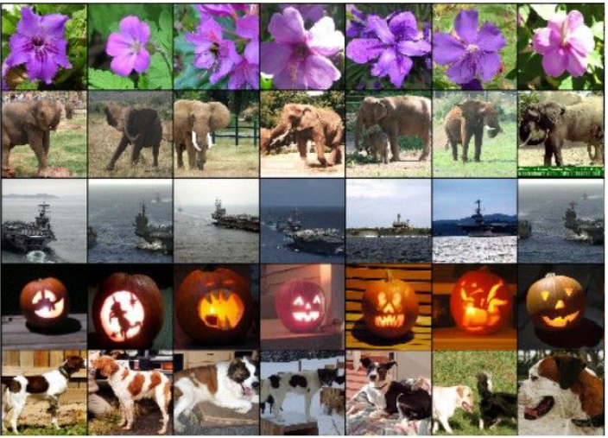
CNN Applications: Image Retrieval
Source: Alex Krizhevsky, 2012

Slide 5
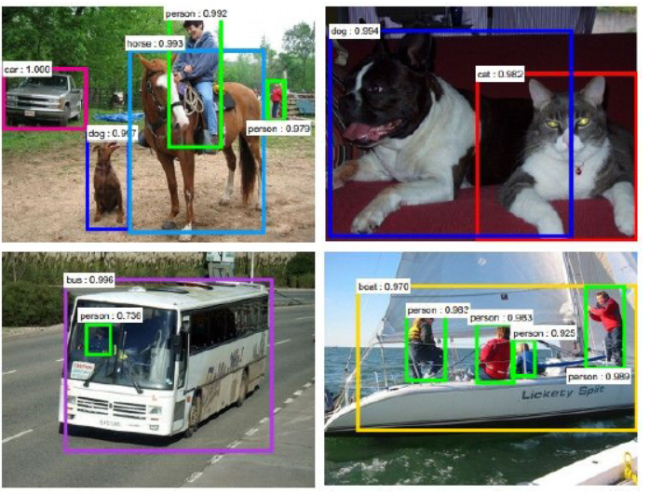
CNN Applications: Object Detection
Source: Faster R-CNN: Ren, He, Girshick, Sun 2015

Slide 6
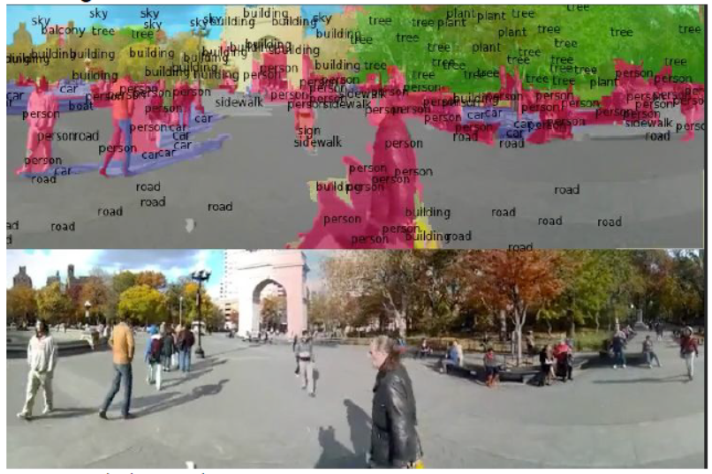
CNN Applications: Segmentation
Source: Farabet et al., 2012

Slide 7
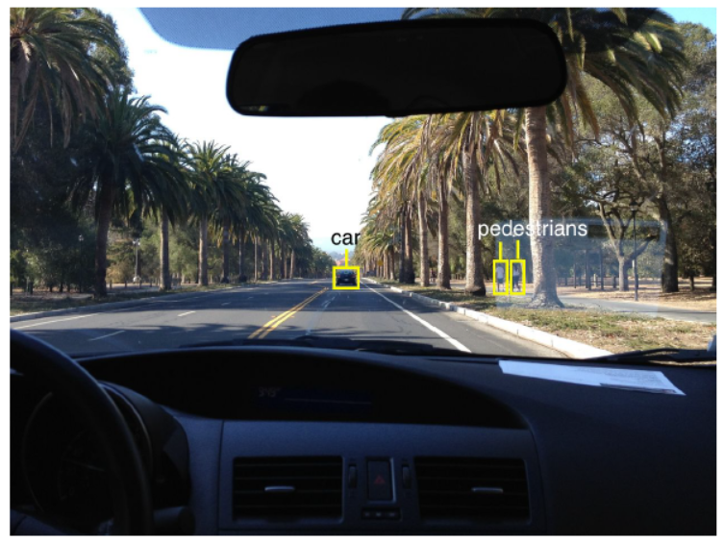
CNN Applications: Self Driving Car
Source: Fei Fei Li slides

Slide 8
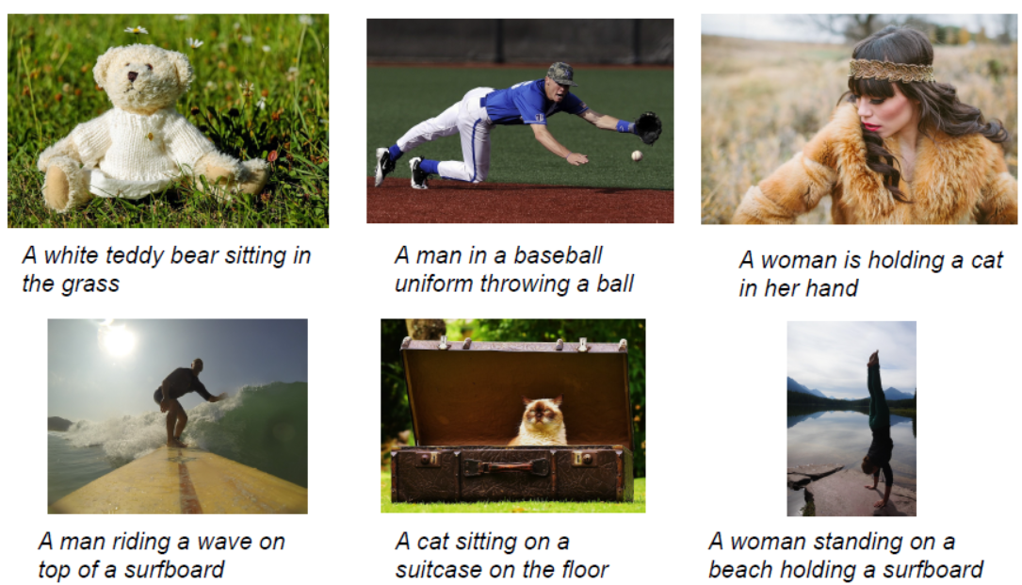
CNN Applications: Image Captioning
Source: Vinyals et al., 2015, Karpathy and Fei-Fei, 2015

Slide 9
Why not Fully Connected Net?
Think about a 12 megapixel image:
# pixel = 4247 x 2826
Possible approach
Convert the matrix to vector
Apply Fully connected layer
Let us do a simple math
One hidden layer with 10000 neurons
# parameters =

Slide 10
Building Blocks of CNN
Convolutional layer operation
Performs Convolution operations
Pooling layer
Performs pooling operation
Usually max pooling
Fully connected layer
Activation layer: relu, sigmoid etc.

Slide 11
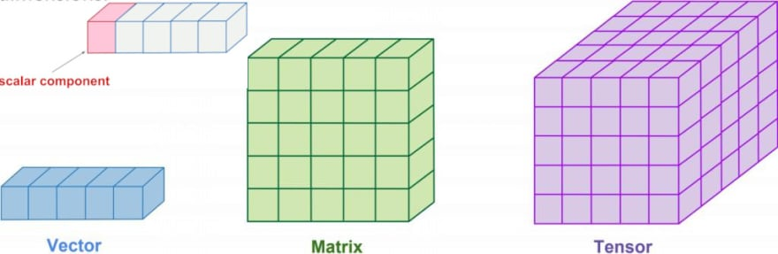
Few useful Definitions
Vector: One dimensional array of n elements
Matrix: Two dimensional array
Tensor: Multi-dimensional array

Slide 12
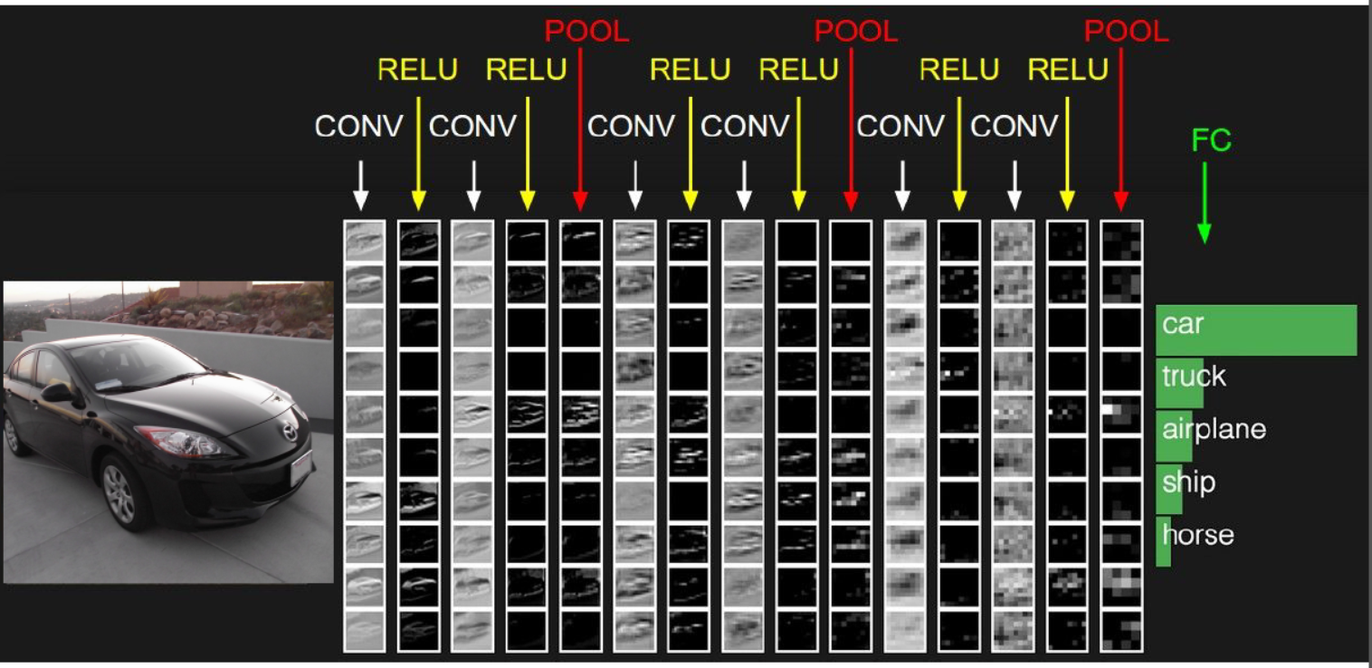
CNN: An Example

Slide 13
Convolutional Operation

Slide 14
Convolution Over Grey image (1 channel)

Slide 15
Convolution Over Grey image (1 channel)

Slide 16
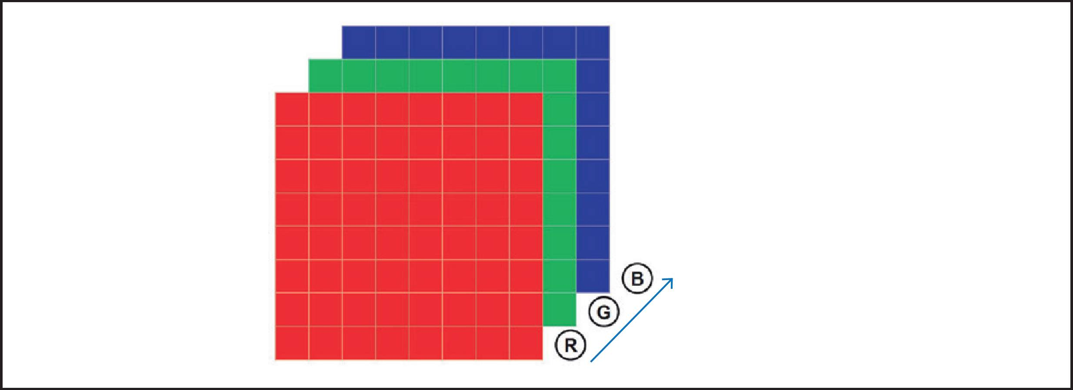
Color Image: RGB
3 channels: Red, Green, Blue

Slide 17
Convolution Over RGB image (multi-channel)

Slide 19
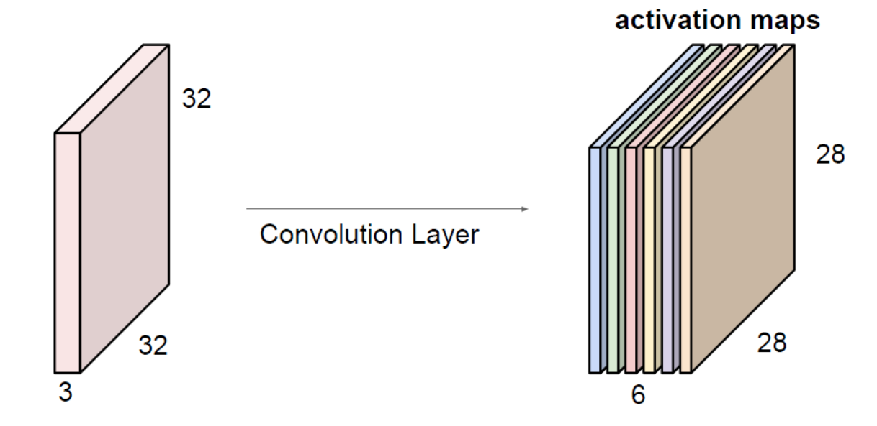
Convolution Layer: Pictorial view
5 X 5 filters
# filters = 6

Slide 20
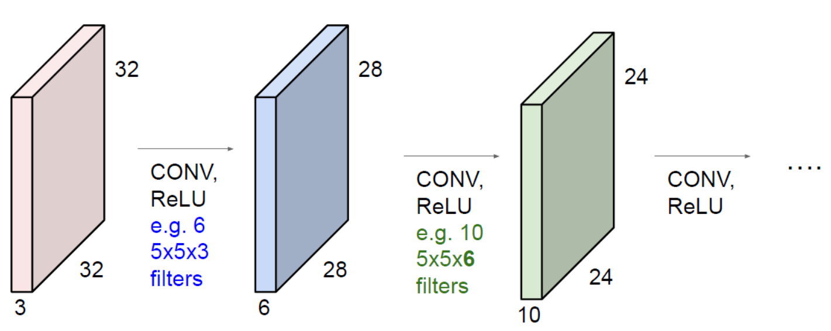
Sequence of Convolution in CNN
ConvNet is a sequence of Convolution Layers, interspersed with activation functions

Slide 21
Stride

Slide 22
Padding

Slide 23
Convolution Layer: Quiz
Input volume: 32x32x3
5x5 filters with stride 1, pad 2
# filters = 10
What is the output volume size?

Slide 24
Convolution Layer: Quiz
Input volume: 32x32x3
5x5 filters with stride 1, pad 2
# filters = 10
What is the number of parameters in this layer?

Slide 25
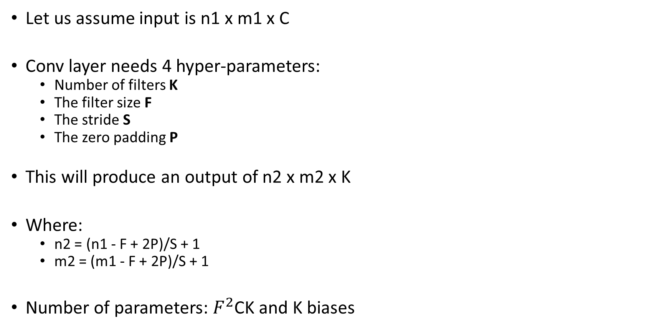
Convolution Layer: Summary
Let us assume input is n1 x m1 x C
Conv layer needs 4 hyper-parameters:
Number of filters K
The filter size F
The stride S
The zero padding P
This will produce an output of n2 x m2 x K
Where:
n2 = (n1 - F + 2P)/S + 1
m2 = (m1 - F + 2P)/S + 1
Number of parameters: $F^{2}$CK and K biases

Slide 26
Pooling

Slide 27
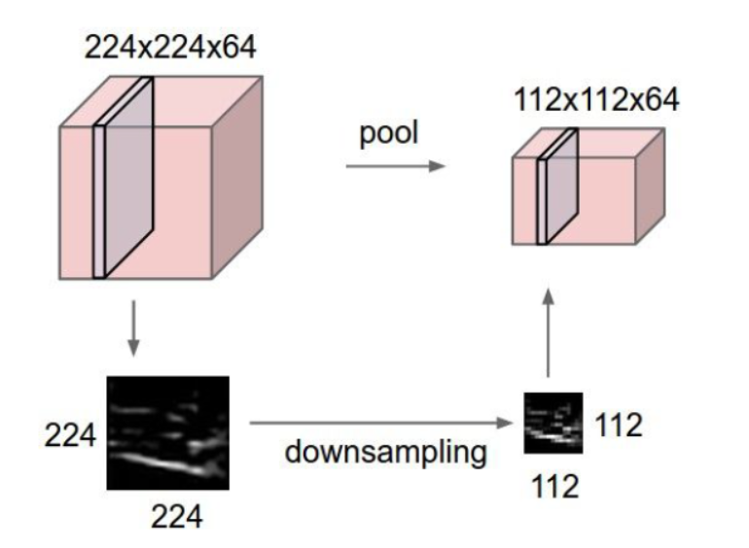
Pooling Layer
makes the representations smaller and more manageable
operates over each activation map independently

Slide 28
Pooling Illustration

Slide 29
Pooling Layer: Summary
Let us assume input is n1 x m1 x c1
Pooling layer needs 2 hyper-parameters:
The spatial extent F
The stride S
This will produce an output of n2 x m2 x c2 where:
n2 = (n1 - F )/S + 1
m2 = (m1 - F)/S + 1
Number of parameters: 0

Slide 30
Fully Connected Layer

Slide 31
Popular CNN Architectures

Slide 32
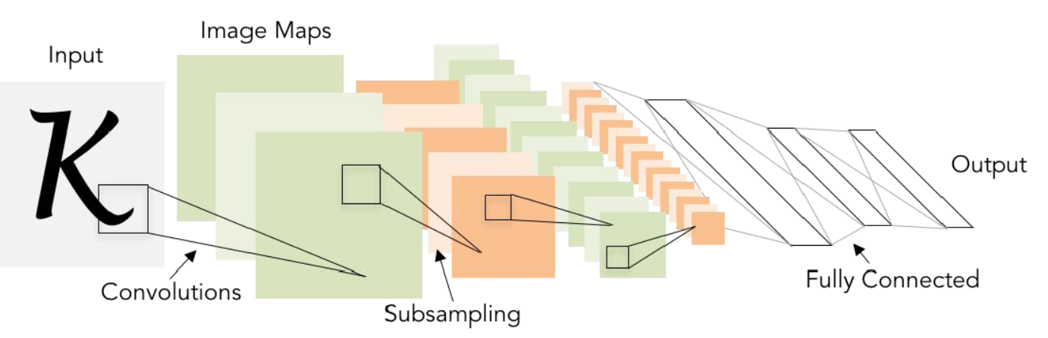
Lenet-5
Conv filters of size 5x5, with stride 1
Pooling layers were 2x2 applied with stride 2
The architecture is [CONV-POOL-CONV-POOL-FC-FC]

Slide 33
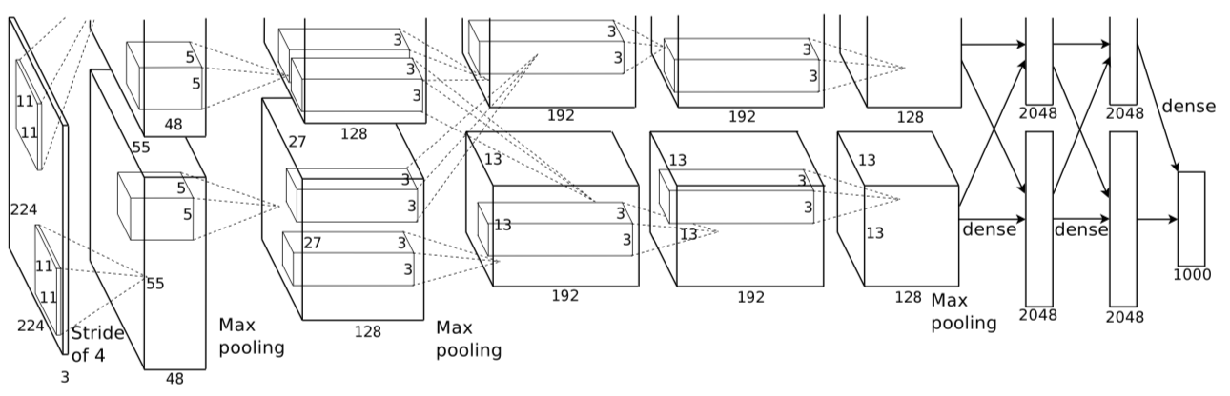
Alexnet
AlexNet architecture (1000 class data):
[227x227x3] INPUT
[55x55x96] CONV1: 96 11x11 filters at stride 4, pad 0
[27x27x96] MAX POOL1: 3x3 filters at stride 2
[27x27x96] NORM1: Normalization layer
[27x27x256] CONV2: 256 5x5 filters at stride 1, pad 2
[13x13x256] MAX POOL2: 3x3 filters at stride 2
[13x13x256] NORM2: Normalization layer
[13x13x384] CONV3: 384 3x3 filters at stride 1, pad 1
[13x13x384] CONV4: 384 3x3 filters at stride 1, pad 1
[13x13x256] CONV5: 256 3x3 filters at stride 1, pad 1
[6x6x256] MAX POOL3: 3x3 filters at stride 2
[4096] FC6: 4096 neurons
[4096] FC7: 4096 neurons
[1000] FC8: 1000 neurons (class scores)

Slide 34
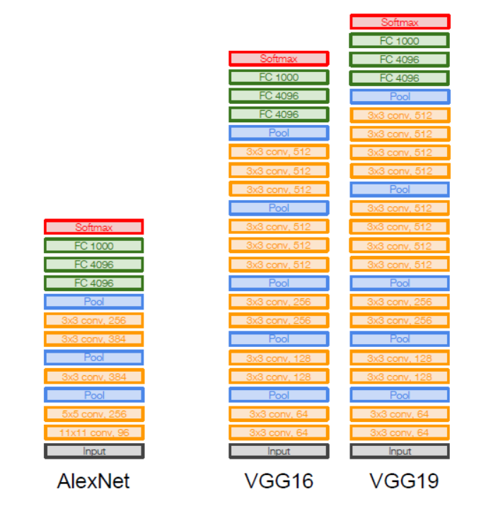
VGGNet
Small filters, deeper network
3x3 CONV stride 1, pad 1
2x2 MAX POOL stride 2

Slide 35
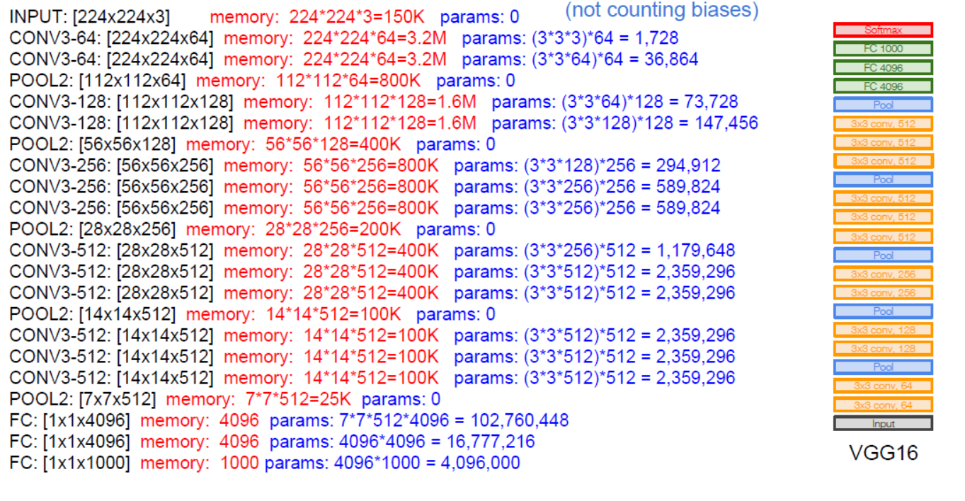
TOTAL params: 138M parameters
Source: Fei Fei Li

Slide 36
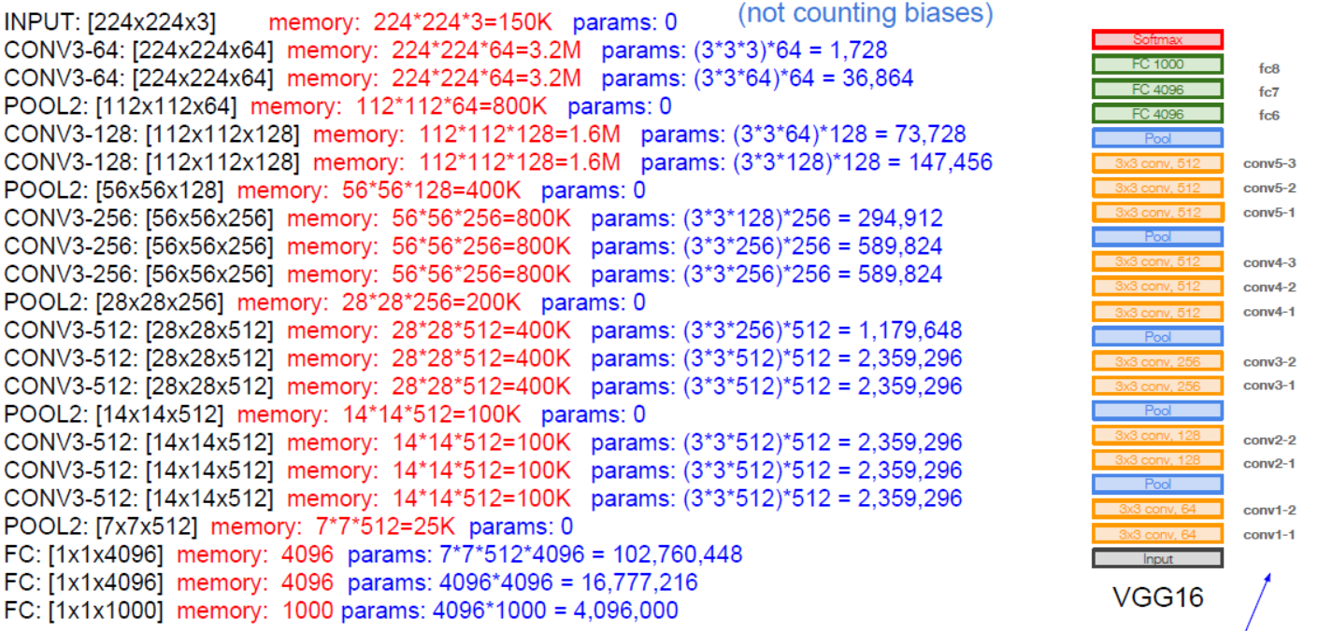
VGGNet: Layer Naming Conventions
Layer names

Slide 37
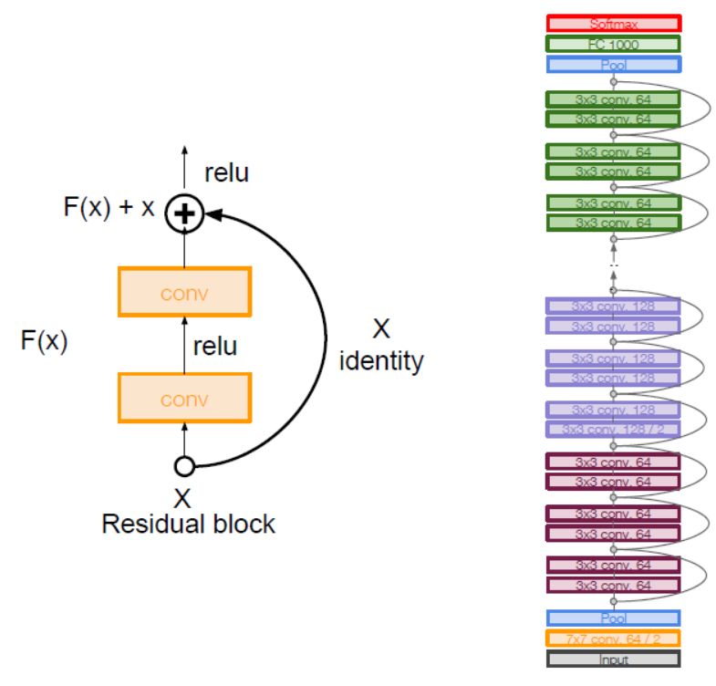
Resnet
Very Deep Nets with Residual Connections

Slide 38
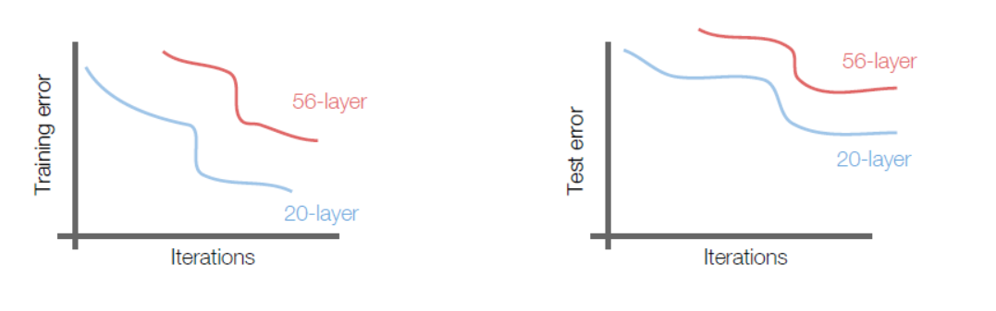
Resnet
What happens if we continue stacking deeper layers on a plain convolutional neural net?
56-layer model performs worse on both training and test error
The deeper model performs worse, but it’s not caused by overfitting!

Slide 39
Resnet: Design Principles
Deeper models are harder to optimize
The deeper model should be able to perform at least as well as the shallower model.
A solution by construction
Copy the learned layers from the shallower model
Set additional layers to identity mapping.

Slide 40
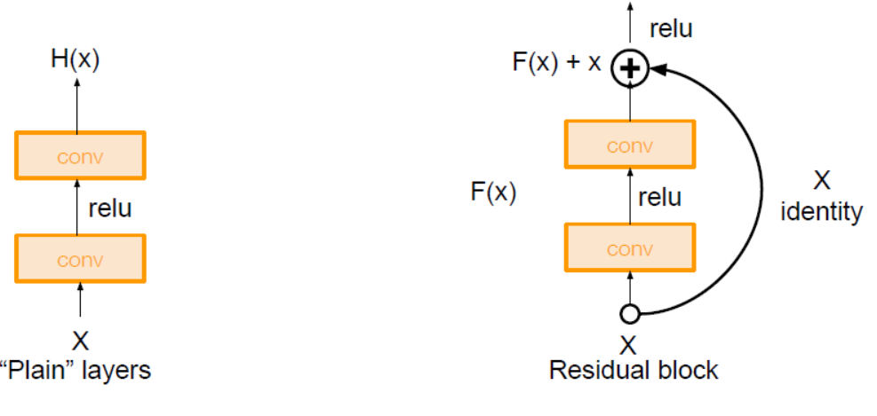
Resnet: Residual Block

Slide 41
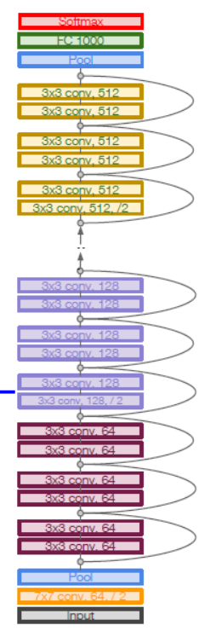
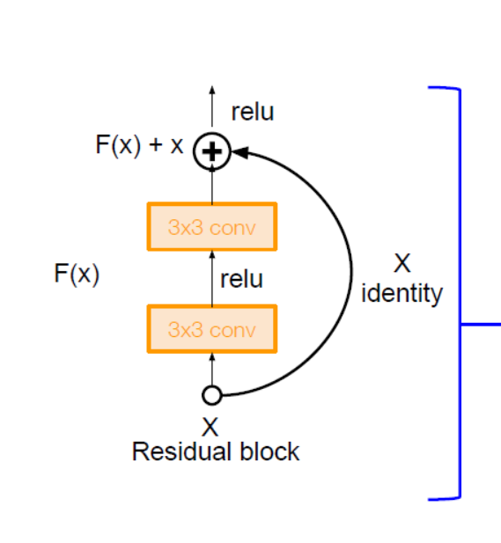
Resnet Full Architecture
Stack residual blocks
Every residual block has two 3x3 conv. layers

